Slide 1
Displaying XML Data with XSLT

Slide 2
What is XSL?
XSL, or the eXtensible Stylesheet Language, is a language used for transforming XML data from one format to another.
Realize that XSLT transforms an initial XML document to a different XML document! That is, after the transformation we are still left with an XML document, not text.
For example, using XSL we can translate XML into XHTML, and thereby display XML data in a Web page. (XHTML is HTML formatted according to XML rules.)

Slide 3
What is XSL?
XSL consists of three parts:
  XSLT – (XSL Tranformation) the syntax used for transforming an XML document to another format.
  XPath – the syntax used to access particular elements or attributes of an XML document.
  XSL Formatting Objects – a syntax for formatting XML documents based on their data and for formatting data differently based on the device viewing the data.
We will only be discussion XSLT and XPath. For more information on XSL Formatting Objects, see: http://www.w3.org/TR/xsl/slice6.html

Slide 4
What is XSL?
In this presentation, we’ll examine how to use XSLT to transform an XML document into HTML. However, XSLT can be used to transform XML format to any other text format.
We’ll examine the .NET Framework’s XslTransform class, as well as the ASP.NET Xml Web control.
Before we begin, though, we need to examine XPath.

Slide 5
XSLT – XSL Transform
XSLT is a syntax for transforming XML data into an alternate format.
The XSLT syntax can appear in an XML-formatted file (typically with a .xsl extension).
The XSLT commands are designed to allow for iterating through a list of XML elements, and retrieving the text and/or attribute values of specific XML elements.

Slide 6
The Basic Structure of XSLT
The root element for an XSLT file is the <xsl:stylesheet> element. (Note the xsl namespace.)
<?xml version="1.0" encoding="UTF-8" ?>
<xsl:stylesheet version="1.0"
xmlns:xsl="http://www.w3.org/1999/XSL/Transform">
… XSLT syntax goes here …
</xsl:stylesheet>

Slide 7
A Quick Refresher on Namespaces
XSLT uses the xsl namespace, which is specified via:
<xsl:stylesheet version="1.0"
xmlns:xsl="http://www.w3.org/1999/XSL/Transform">
Note that the xsl namespace prefix is used. It’s namespace value must be the specific URL you see above…

Slide 8
The Components of XSLT
Recall that XSLT is expressed as an XML-formatted document.
There are a number of common XSLT elements that specify how the XML data should be transformed:
  <xsl:template>
  <xsl:for-each>
  <xsl:value-of>

Slide 9
Examining <xsl:template>
An XSLT document can contain an arbitrary number of <xsl:template> elements.
Each <xsl:template> element must include a match attribute, whose value is an XPath expression that indicates what XML nodes the <xsl:template> tag will work with.

Slide 10
Examining <xsl:template>
For example, if we wanted to list each file on the filesystem, we’d need to first add an <xsl:template> element that matches with the <file> elements.
<?xml version="1.0" encoding="UTF-8" ?>
<xsl:stylesheet version="1.0"
xmlns:xsl="http://www.w3.org/1999/XSL/Transform">
<xsl:template match="/filesystem//file">
…
</xsl:template>
</xsl:stylesheet>

Slide 11
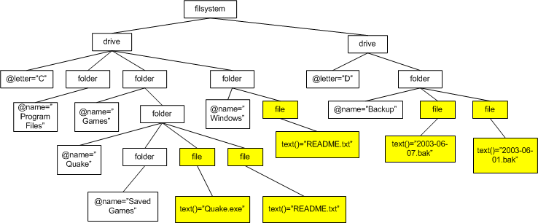
Example of <xsl:template>
<xsl:template match="/filesystem//file">

Slide 12
Examining <xsl:value-of>
The <xsl:value-of> element accesses the text or attribute value of an element.
The <xsl:value-of> element requires a select attribute, which specifes the name of the element whose text node to retrieve, or the attribute name.

Slide 13
Example using <xsl:value-of>
The following XSLT document would output the names of all of the folders in the file system.
<?xml version="1.0" encoding="UTF-8" ?>
<xsl:stylesheet version="1.0"
xmlns:xsl="http://www.w3.org/1999/XSL/Transform">
<xsl:template match="/filesystem/drive//folder">
<xsl:value-of select="@name" />
</xsl:template>
</xsl:stylesheet>

Slide 14
Examining <xsl:for-each>
The <xsl:for-each> element iterates through all of the children elements of a specified element. The <xsl:for-each> element has a select attribute (like <xsl:value-of>), which specifies which element’s children to iterate through.
<xsl:template match="/filesystem/drive">
<xsl:value-of select="@letter" />
<xsl:for-each select="folder">
<xsl:value-of select="@name" />
</xsl:for-each>
</xsl:template>
What would this XSLT document’s output be?

